Slide 1








Planning Ahead:
Personal Directive Workshop
[insert date]
Notes:
Welcome, everyone. Thank you for attending this Personal Directive workshop!
I’m ____ and I’ll be your MC for tonight.

Slide 2

Land Acknowledgement
We are grateful to live, work and play on Treaty 6, 7 and 8 territories. We respect the histories, languages, and cultures of First Nations, Métis, Inuit, and all First Peoples of Canada, whose presence continues to enrich our vibrant community.

Slide 3


Notes:
Introductions, facilities (e.g., washrooms, exits), please quiet your devices

Slide 4

Outline
Presentation Personal directives: part of “advance care planning” Tips for preparing your personal directive | 6:30-7:00
Learning and preparing hands-on activities | 7:00-7:55
Wrap up | 7:55-8:00
Notes:
Go through high level overview of the night, introduce the speaker who will be delivering the formal presentation part of the workshop

Slide 5

Mr. Singh
Notes:
To help us think about this topic, we’d like to start with a scenario.
Mr. Singh, a 72‑year‑old man, is admitted to the hospital after a severe bout of pneumonia. After several days of treatment, his pneumonia improves. However, complications from the pneumonia have left him confused and disoriented. A medical assessment determines that he does not have the capacity to make his own decisions—at least temporarily. His family says that he does not have a personal directive, so no one is legally named to make decisions for him.
After a few more days, Mr. Singh no longer needs hospital-level care, but it is not safe for him to go home without support. His three adult children are caring and willing to help, but they disagree about where he should go. Amrit wants to find him a care facility. Gurpreet insists he should return home with home‑care. Navjot wants to postpone the decision altogether, claiming their father “just needs more time.” Their disagreement leaves the discharge process stalled. Since no one has legal authority and no consensus can be reached, Mr. Singh remains in hospital unnecessarily while the team begins the lengthy process of seeking a court‑appointed decision-maker—delaying his recovery and occupying a bed urgently needed for new patients.
This scenario illustrates that no one has the legal authority to make personal or medical decisions for you if you lose capacity – not your spouse, adult children, or nearest relative. Preparing a personal directive can help ensure your family or friends don’t have to go to court to become your decision-maker.
By preparing a personal directive, you get to choose who you want to make decisions for you, and have a say in your care.

Slide 6




Personal directives: part of “advance care planning”
Notes:
We’re here tonight to talk about personal directives, which are part of a larger process called “Advance care planning”. Advance care planning is how you think about, talk about and record the health and personal care you want to receive now and in the future, especially in the event you cannot speak for yourself.

Slide 7


Advance care planning is . . .
For every adult
at any point in life
Best done when a person is healthy, before there is an urgent need for it
Notes:
As per slide

Slide 8






The 5 steps of advance care planning
Notes:
There are five steps in advance care planning.
The first step is to think about your values and goals. What brings you joy and makes your life meaningful? If you were to get very sick, what would matter most to you? One of the activities later tonight focuses on this step.
The second step is to learn about your health. Talk to your doctor or healthcare provider and learn about any specific health concerns, treatments available, what to expect in the future, and what kinds of decisions might need to be made.
Step three is to choose an agent – this is the term used in Alberta for the person you want to make health and personal decisions for you if you were ever too sick or injured to make your own decisions. We’ll talk a little bit more about what to think about when choosing an agent in a few minutes.
Step four is to share your wishes with your agent, the people you trust and your healthcare team.
The last step is to name your agent and record any specific wishes in a personal directive.

Slide 9
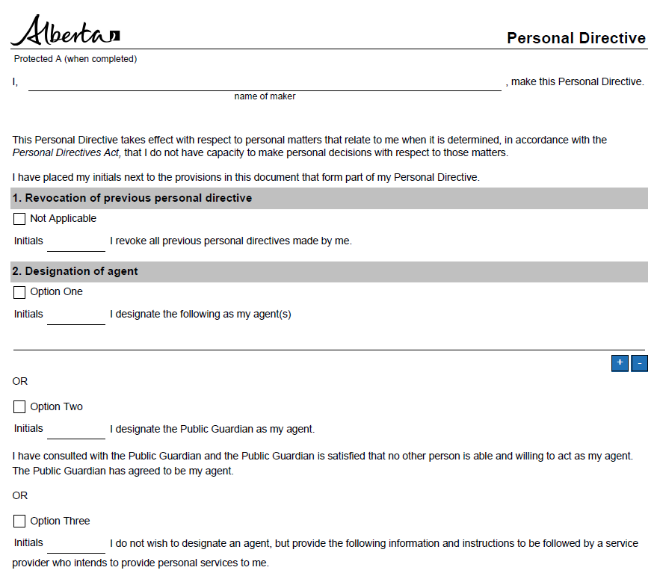
What is a personal directive?
A personal directive is a legal document you make in case you cannot make your own personal decisions in the future.
A personal directive:
names the person or people you want to make decisions for you – your “agent(s)”
only comes into effect if you lose capacity to make your own decisions
Notes:
Personal directives are recommended for all adults.
Read info on slide, then…
This last point is important – a common misperception is that the personal directive comes into effect immediately, but this is not the case.
You may already have a personal directive if you’ve been to a lawyer to do your will – oftentimes these planning documents are done as a package – will, enduring power of attorney for finances, and personal directive.

Slide 10
What kinds of decisions can your agent(s) make?
Any personal decisions that are not financial, such as:
your health care
where you will live
who can visit you
who will care for your children
your participation in social, educational & employment activities
who can access your personal or medical information.
Notes:
your health care (e.g., medical treatments, procedures, medications)
where you will live
who can (and cannot) visit you
who will care for your children if you lose capacity
your participation in social, recreational, educational and employment activities
who can or cannot access your personal or medical information.

Slide 11

Three options for creating a personal directive
Fill out the Government of Alberta’s Personal Directive form.
Use the government form as a guide and write your own personal directive.
Meet with a lawyer.
Notes:
As per slide

Slide 12
Personal directive tips
Notes:
Now we’d like to share some tips for preparing your personal directive.

Slide 13

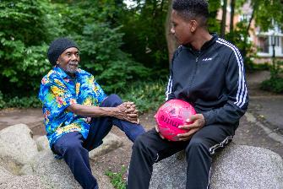


Choose your agent thoughtfully
Willing and available?
Knows you well and what’s important to you?
Comfortable directing others?
Emotionally capable?
Organized?
Notes:
The first tip is around considerations for choosing your agent. And one of our hands-on activities later this evening that will help you explore this in more detail.
Willing and available? - are they willing to act and take on this responsibility, do they live close (or at least in same time zone!), are they relatively healthy such that they’ll be available to act when needed
Knows you well & what’s important to you? – is this someone you trust to make decisions based on your values and wishes?
Comfortable directing others? – are they a clear communicator, would they be comfortable directing others like your family and your doctors? Will they work well with your Enduring Power of Attorney?
Emotionally capable? Are they able to make difficult decisions in stressful situations?
Organized? – are they well organized (there are some record keeping requirements to the role)

Slide 14

Let your agent(s) know they’ve been named
Did you know? Many people are surprised to find out they’ve been named as an agent in someone’s personal directive.
Notes:
As per slide. Then,
If possible, is strongly recommended that you get your agent’s consent to be named in your personal directive. Ask your proposed agent(s) if they are willing, able and available to take on this role, so they can make an informed decision about taking on this responsibility.

Slide 15
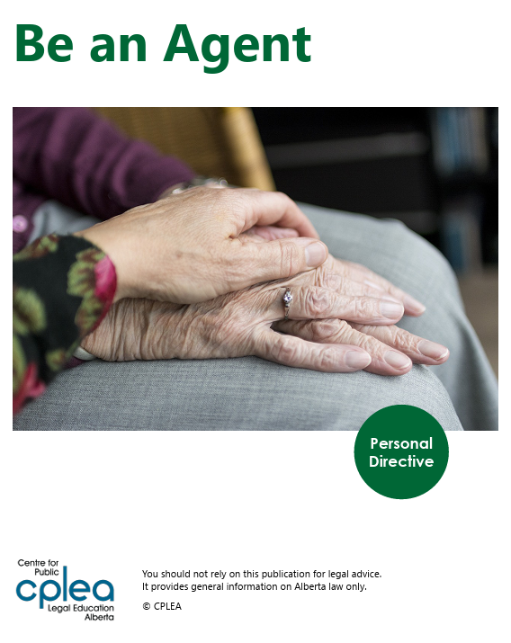
Prepare your agent(s) for their role
Give your agent(s) a copy of your personal directive.
Talk to your agent(s) about your values, wishes and goals.
Consider inviting your agent(s) to medical and legal appointments.
Notes:
Talk to your agent(s) about your beliefs, values, wishes and goals for the future, so they know what’s important to you. Revisit these conversations over time.
Consider inviting your agent(s) to medical and legal appointments – as acceptable to you (not everyone will want this for privacy reasons).
Point your agent(s) toward additional resources to help them understand their role. This guide from the Centre for Public Legal Education Alberta is a great resource (and we have several here tonight so you can take one home) that helps to clarify agent roles.

Slide 16

Focus on your values
Unless you have a specific diagnosis (where upcoming decisions are foreseeable), focus on your values rather than specific medical treatments.
Sharing your values can provide context for your agent(s) and care providers, to guide their decision-making in a range of unforeseen situations.
Notes:
As per slide, plus…
Often, people focus on instructions about specific healthcare interventions, which may not be relevant to their current or future health condition and risk paralyzing those who are attempting to interpret them.
It is nearly impossible to predict all the decisions that may need to be made in the future. And, what may seem unacceptable to us now may be acceptable in the future.

Slide 17
Talk to your doctor or healthcare provider(s)
Talk to your doctor or healthcare provider(s) to understand your health.
"What are my medical issues and diagnoses? How might my illness impact my quality of life moving forward?“
“Given my diagnosis, what treatment decisions might I need to make in the near future?“
Notes:
Especially if you have a specific illness or diagnosis, it’s important to talk to your healthcare team to learn more about your health. Some questions you might want to ask are: is my illness likely to get worse over time? What stage of my illness am I in right now? What changes should I expect with my illness? What decisions might I need to make as my illness changes?

Slide 18
Hands-on activities
Notes:
We will now move into the ‘hands-on’ part of the workshop, to help you learn more and prepare to complete your personal directive. We have two activities planned, and we’ll spend about 15-20 minutes on each one.

Slide 19

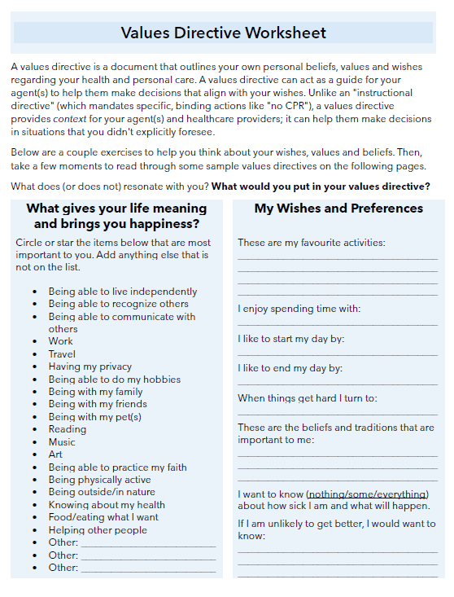
Activity 1: Identifying and sharing your values and preferences for care
Resources for identifying “What matters most?”
Notes:
The first exercise we have for you tonight is around identifying and sharing your values and preferences for care.
As we mentioned earlier in tonight’s presentation, focusing on your values, beliefs and preferences- what matters most to you- can provide context for your agent(s) and care providers, to guide their decision-making in a range of unforeseen situations. Because it’s hard to predict every possible medical situation, we recommend people focus less on listing specific medical instructions (like, “I never want a feeding tube”) in their personal directive, and more on their values and preferences for care (exception would be if you have a significant health condition, where upcoming decisions are reasonably foreseeable).
Identifying and sharing your values and preferences offers more flexible guidance that can help your agent and healthcare providers make decisions that fit with your overall wishes, even in situations you didn’t anticipate.
We recognize that trying to identify and articulate our values and wishes can be hard – it’s not something we’ve probably all thought about a lot – but there are some good resources to help – and you will find both of these on your tables.
One is the My Wishes Alberta workbook – this is a fillable workbook that has a number of prompting questions to help you identify what is important to you, what brings you joy and makes your life meaningful, and what you would want others to know about you if you were to get very sick. You can answer the questions in the workbook, and/or you can use it as a guide to help you have conversations with those close to you and your healthcare team.
The other resource is a values directive worksheet. A values directive can be another way to document your personal beliefs, values and wishes regarding your health and personal care. The values directive worksheet on your tables has a few exercises to help you think about your wishes, values and beliefs, and then also has a few examples of real values directives written by others, if you’re someone who is inspired by seeing real-life examples.
So we’ll give you about <15 minutes> at your tables to explore both – you may find that one resonates more with you than the other, and that’s fine. Or you may want to do both. You can choose to include a values directive or values statements in your actual personal directive document, or you can provide it to your agent and your healthcare team for them to use as a guide. But the important point is to share these with your agent and those close to you.
Our team will be floating around the room to check-in and answer any questions you might have. Feel free to chat at your tables or with your neighbor, or review quietly on your own, whichever you prefer. We’ll reconvene at about 7:30.

Slide 20
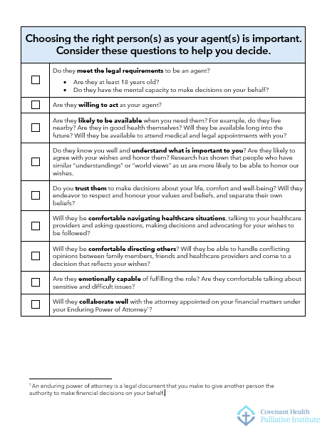
Activity 2: Choosing an agent
Notes:
This second activity focuses on what you should consider when choosing your agent.
Under Alberta’s personal directive law, your “agent” is someone you choose to make decisions for you if you lose capacity. This person can make decisions on your health care (for example, what tests or treatment you should have/not have) and personal matters (for example, where you might live, who might visit you). This person can’t make financial decisions (this is done through a different document called an “Enduring Power of Attorney”, which we’re not focused on today).
Choosing an agent is very significant: this person stands in your place if you lack capacity to make decisions. They make important decisions (sometimes in emergencies), they request information and communicate (and advocate) on your behalf, and they interpret what you would want and not want from your personal directive and from what they know about your values, beliefs, goals and wishes.
On your tables, you’ll find a checklist of qualities to think about when selecting your agent. You may not have a candidate that meets everything on this list but it’s a tool to help you to pick a strong candidate for the role. We’ve also included an excellent free resource “Be An Agent” produced by the Centre for Public Legal Education Alberta that you’re welcome to take and provide to whoever you choose as your agent.
So again we’ll give you about 15 minutes to look through these resources and then we’ll reconvene at about 7:50. If you have any questions or want to talk something through, our team will be floating around the room.

Slide 21
Wrap-up

Slide 22

Notes:
Congratulations on taking this important step in planning for your future! We hope you got some helpful information and resources you can use.

Slide 23

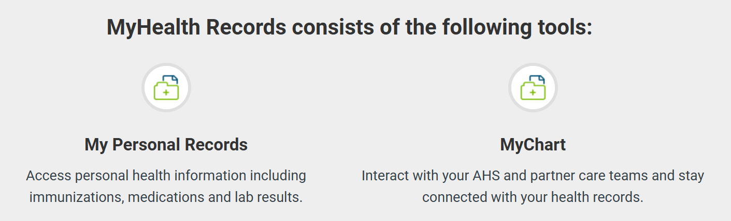
Sharing and storing your personal directive
Give a copy to your agent(s).
Put a copy in your Green Sleeve (if you have one).
Upload to MyChart: https://myhealth.alberta.ca/myhealthrecords#
Notes:
Once you have completed your personal directive – make sure to share it in the following ways:

Slide 24
The 5 steps of advance care planning
Notes:
And remember that documentation is only one part of advance care planning – make sure to keep having conversations and share your wishes with those close to you.

Slide 25
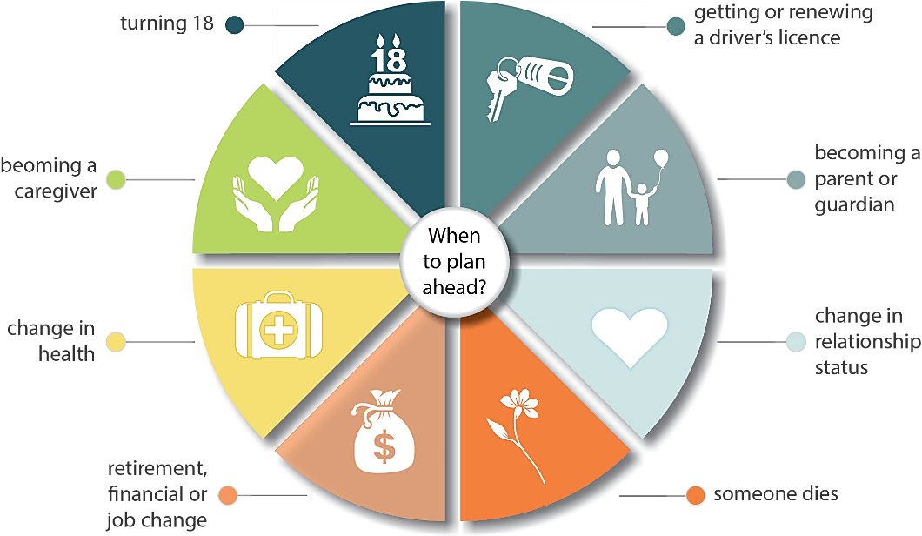
Advance care planning is an ongoing process
The 6 Ds:
When you reach a new decade
With the death of a loved one
With a divorce
With a new diagnosis of a significant health condition
With a significant decline in your health or functioning
With a change in domicile (where you live) or someone moves in with you
becoming a caregiver
Notes:
And remember that advance care planning is an ongoing process. There are various milestones and life events that can be helpful prompts for reminding you to revisit your advance care planning, as shown in this life journey graphic on the left. The 6 Ds are another helpful mnemonic.

Slide 26

Contact us:
[insert contact info]
Please complete the evaluation survey!
Notes:
Please check out the resource table before you leave, help yourself to more food, and please complete the evaluation survey before you go.
THANK YOU!!

